Slide 1
Change and Release Managment
INFO6255 Software Quality Contrl & Mgmt
Fall 2019
Medi Servattalab
M.Servattalab@northeastern.edu

Slide 2

Change vs. Release Management
What are Change & Release Management?
What are their differences?
What are their processes?
ITIL Definitions and Services
ISO 20000 Certification

Slide 3
Definition of a "Change"
According to ITIL, a Change is "the addition, modification or removal of any authorized, planned, or supported service or service component that could have an effect on IT services."
Most often, a change is an event that has been approved by the change authority, is evaluated and implemented while minimizing risk, adjusts the status of a configuration item (CI), and adds value to the business and its customers.

Slide 4
Change Management
ITIL Change Management – “It is the quality control process that sets the stage ready by assessing, planning and getting the right approvals for deployment of one or multiple changes to ensure minimal disruption to live environment”.
The objective of Change Management is to ensure that standardized methods and procedures are used for efficient and prompt handling of all changes to control IT infrastructure, in order to minimize the number and impact of any related incidents upon service.

Slide 5
Types of Changes
Emergency Change/Urgent Change
Standard Change
Major Change
Normal Change
Change Requests may include:
Application Changes
Hardware Changes
Software Changes
Network Changes
Documentation Changes
Environmental Changes
https://www.cherwell.com/library/essential-guides/essential-guide-to-itil-change-management/

Slide 6
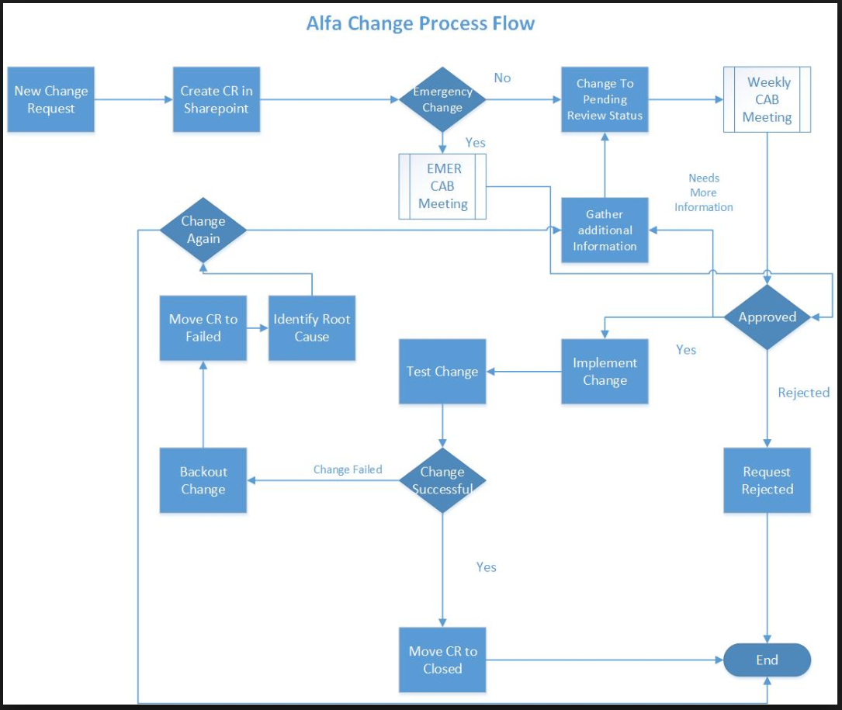
Change Management Process
CAB: Change Advisory Board
CR: Change Request

Slide 7
The Definition of a “Release”
A release (or a Software Release) is the distribution of the final version of an application. A software release may be either public or private and generally constitutes the initial generation of a new or upgraded application.
A release is preceded by the distribution of Pilot versions of the software.

Slide 8
Release Management
Release Management is the process of managing, planning, scheduling and controlling a software build through different stages and environments; including testing and deploying software releases.
ITIL Release Management – “It takes care of the actual “doing” of deploying approved changes.
Release management involves building, testing and batching of one or more changes while maintaining the integrity of ongoing services”

Slide 9
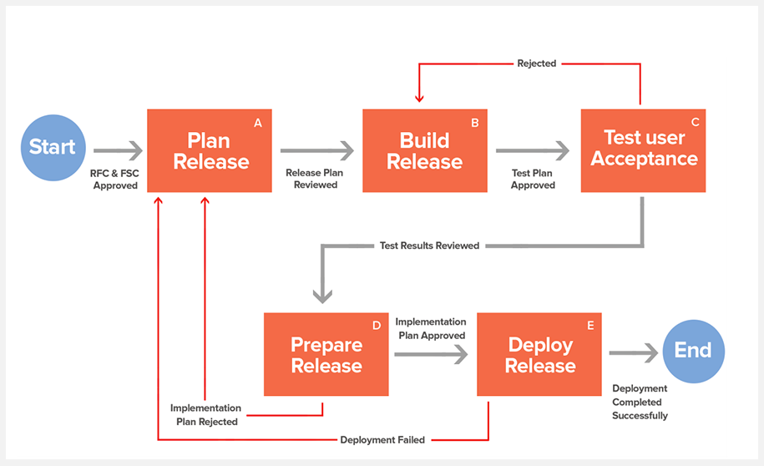

Release Cycle

Slide 10
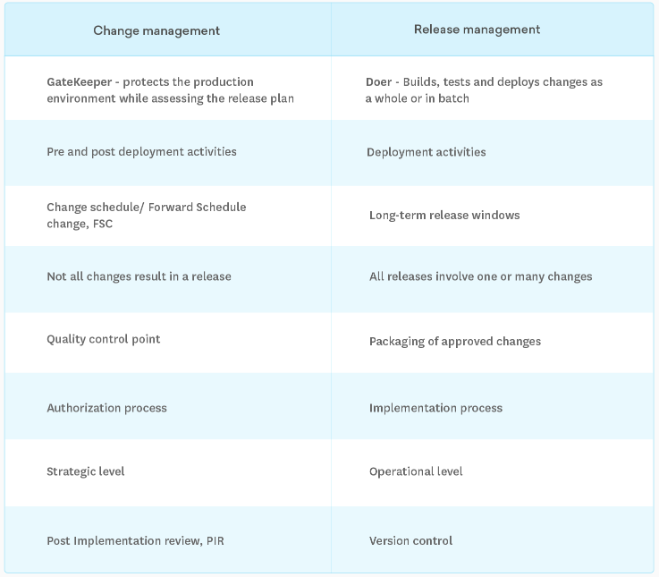
Change Management vs Release Management

Slide 11
What is ITIL?
ITIL stands for: Information Technology Information Library
The ITIL processes within IT Service Management (ITSM) ensure that IT Services are provided in a focused, client-friendly and cost-optimized manner.
With their help, IT Services are clearly defined, success can be measured with regards to the service provision, and targeted improvement measures can be introduced where necessary.

Slide 12
ITIL Processes according to ITIL 2011
The ITIL processes are grouped into stages:
Service Strategy
Service Design
Service Transition
Service Operation
Continual Service Improvement (CSI)
Each of the five stages is focused on a specific phase of a service's lifecycle.

Slide 13
ITIL: Service Strategy
Process Objective: To decide on a strategy to serve customers.
Starting from an assessment of customer needs and the market place, the process determines which services the IT organization is to offer and what capabilities need to be developed.
Its ultimate goal is to make the IT organization think and act in a strategic manner.

Slide 14
ITIL: Service Design
Process Objective: To design new IT services.
The scope of the process includes the design of new services, as well as changes and improvements to existing ones.

Slide 15
ITIL: Service Transition
Process Objective: To build and deploy IT services.
Service Transition also makes sure that changes to services and Service Management processes are carried out in a coordinated way.

Slide 16
ITIL: Service Operation
Process Objective: To make sure that IT services are delivered effectively and efficiently.
The Service Operation process includes fulfilling user requests, resolving service failures, fixing problems, as well as carrying out routine operational tasks.

Slide 17
ITIL: Continual Service Improvement (CSI)
Process Objective: To use methods from quality management in order to learn from past successes and failures.
The process aims to continually improve the effectiveness and efficiency of IT processes and services, in line with the concept of continual improvement adopted in ISO 20000.

Slide 18
What is ISO 20000?
ISO 20000 is the first ever international standard for IT service management.
Its main focus is continual improvement of IT services.
The standard works by setting benchmarks for companies based on evidence.
Achieving these benchmarks proves that a company is capable of consistent excellence.
The requirements include the design, transition, delivery and improvement of services.
Achievement ISO 20000 certification shows an organizations dedication to an advanced IT Service Management approach.

Slide 19
Who can use ISO 20000 Certification?
Organizations seeking services from service providers and requiring assurance that their service requirements will be fulfilled.
Organizations that require a consistent approach by all its service providers, including those in a supply chain.
Service providers which intend to demonstrate their capability for the design, transition, delivery and improvement of services.
Service providers who monitor, measure and review its service management processes and services.
Any IT service organization that wishes to demonstrate an advanced IT service management approach.

Slide 20
ITIL Release Manager Responsibilities
Drive planning & delivery of high-quality enterprise IT software releases.
Manage release schedules and milestones.
Assemble and lead multiple cross-functional teams to support IT application releases of varying size, complexity and duration.
Collaborate and manage release processes across all functions within IT and with business stakeholders
Manage change control processes for the releases.
Implement best practices consistent with an agile development methodology.
Define and manage release readiness and success criteria based on business requirements.
Proactively identify and mitigate risks and remove obstacles to release
Guide the completion of root cause analysis to ensure issues do not recur.
Perform environment planning, provisioning, and management required to support the releases
Provide oversight for deployment of releases into production environments through ensuring release readiness and adequate deployment runlist handoff to Service Delivery.
Communicate plans and status, and escalate issues as required

Slide 21
Version Control System
Benefits:
The main advantages of using a version control system include streamlining the development process, management of code for multiple projects and keeping a history of all changes within a code.
A version control software saves all the changes in a repository. Hence, if the developers make a mistake, they can undo it. At the same time, they can compare the new code with a previous version(s) to resolve their grievance.
This can reduce human errors and unintended consequences to a great extent.
https://hackernoon.com/top-10-version-control-systems-4d314cf7adea

Slide 22
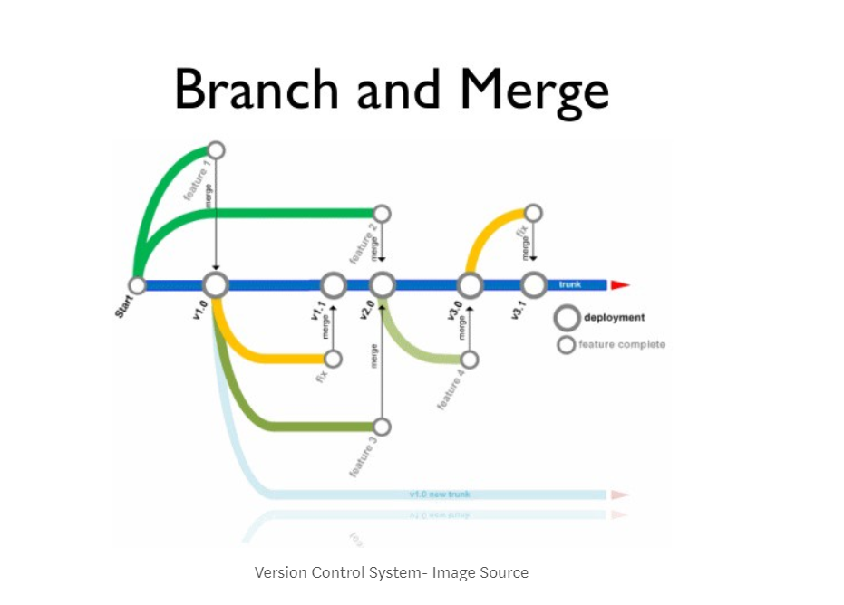
Source or Version Control Systems

Slide 23
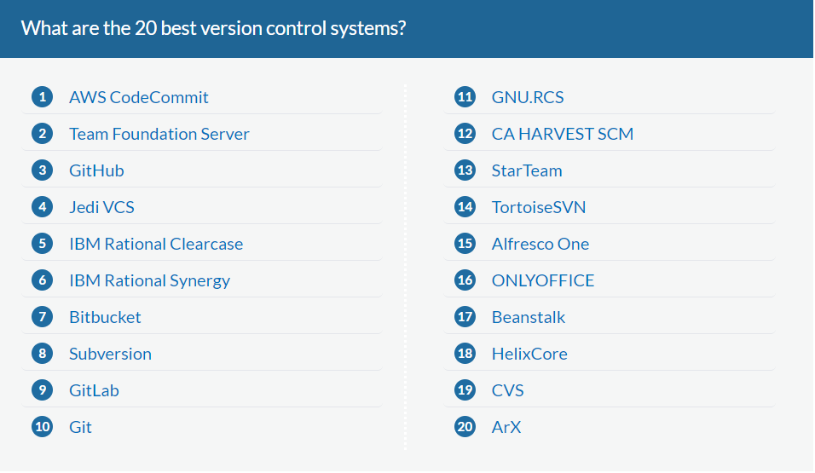
https://financesonline.com/version-control-systems/

Slide 24
Version Control System - Example
CVS Version Control (Concurrent Versions System)
CVS is one of the oldest version control system and is a well-known tool among both commercial and open source developers. It allows you to check out the code you are planning to work on, and check-in the changes.
It has the capability to handle projects with multiple branches so that teams can merge their code changes and contribute unique features to the project.
Since CVS is here for a long time now, it is the most mature version control software.

Slide 25
Change and Release Management ISO-20000 references
https://advisera.com/20000academy/knowledgebase/change-advisory-board-itil-advise-approve/
https://www.cherwell.com/library/essential-guides/essential-guide-to-itil-change-management/
https://www.sunviewsoftware.com/blog/learn/blog/five-changes-that-require-cab-change
https://www.bmc.com/blogs/iso-20000-vs-itil-whats-the-difference-and-how-are-they-related/
http://www.bu.edu/tech/files/2012/06/RM-Quick-Refv3.pdf

